Slide 1
Chapter 9
Database Design

Slide 2
Learning Objectives
After completing this chapter, you will be able to:
Describe the role of database design as the foundation of a successful information system
Describe the five phases in the Systems Development Life Cycle (SDLC)
Design databases using the six phases in the Database Life Cycle (DBLC) framework
Conduct evaluation and revision within the SDLC and DBLC frameworks
Distinguish between top-down and bottom-up approaches in database design
Distinguish between centralized and decentralized conceptual database design

Slide 3
The Information System (1 of 2)
The database is part of a larger whole known as an information system (IS)
Provides for data collection, storage, and retrieval
People, hardware, and software
Database(s), application programs, and procedures
Systems analysis: establishes need for and extent of information system
Systems development: process of creating information system

Slide 4
The Information System (2 of 2)
Performance factors of an information system
Database design and implementation
Application design and implementation
Administrative procedures
Database development
Process of database design and its implementation

Slide 5
Systems Development Life Cycle (SDLC) (1 of 2)
Traces history of an information system
Provides a picture within which database design and application development are mapped out and evaluated
Traditional SDLC is divided into five phases
Planning: yields a general overview of the company and its objectives
Analysis: problems defined during planning phase are examined in greater detail
Detailed systems design: designer completes the design of the system’s processes
Implementation: hardware, DBMS software, and application programs are installed, and the database design is implemented
Maintenance: corrective, adaptive, and perfective
Iterative rather than sequential process

Slide 6
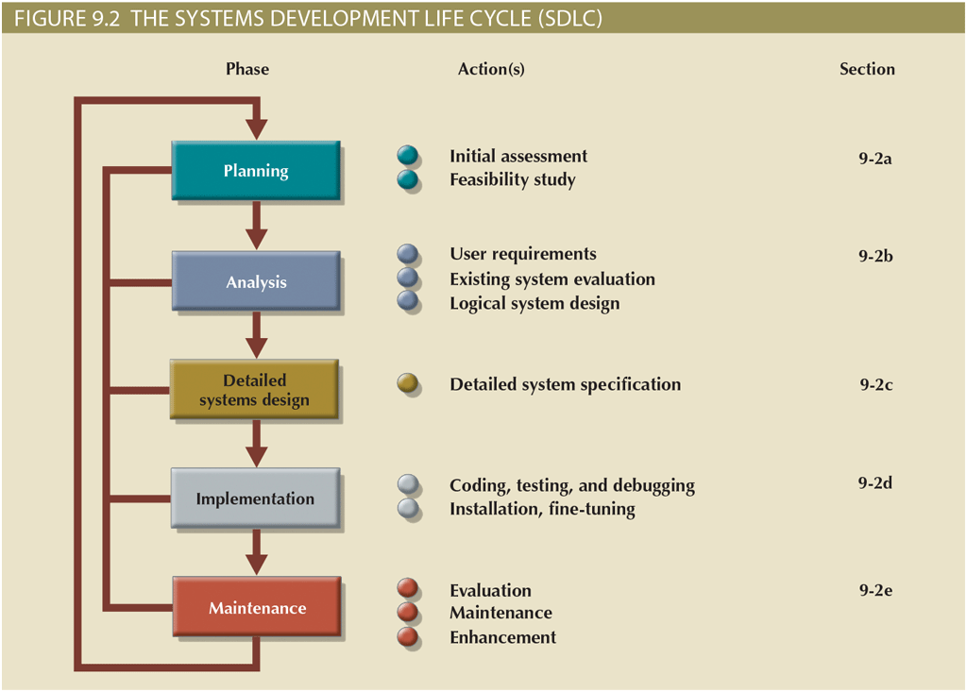
Systems Development Life Cycle (SDLC) (2 of 2)

Slide 7
The Database Life Cycle (1 of 5)
The Database Life Cycle (DBLC) contains six phases
Database initial study: define problems, constraints, objectives, scope, and boundaries
Database design: making sure that the final product meets user and system requirements
Implementation and loading: DBMS is installed, database is created, and data is loaded or converted
Testing and evaluation: database is tested, fine-tuned, and evaluated
Full backup/dump: all database objects are backed up in their entirety
Differential backup: only modified/updated objects since last full backup are backed up
Transaction log backup: only the transaction log operations that are not reflected in a previous backup are backed up
Operation: problems are identified and solutions implemented
Maintenance and evolution: preventative, corrective, adaptive, etc.

Slide 8
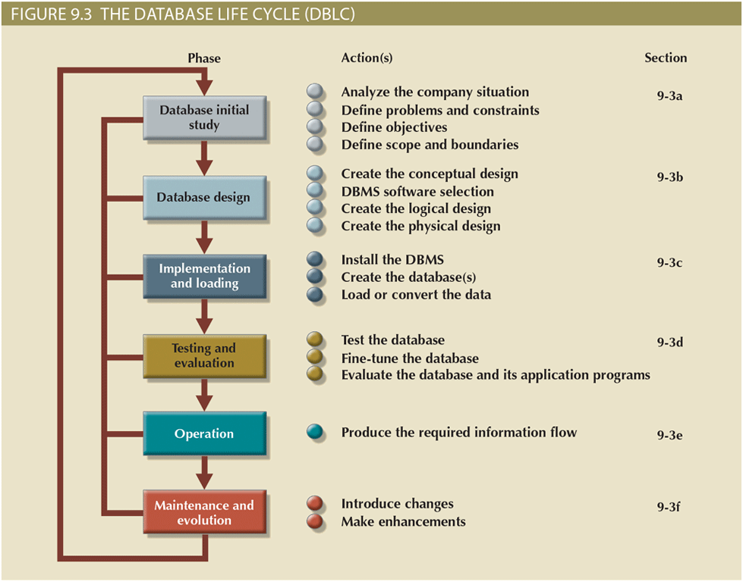
The Database Life Cycle (2 of 5)

Slide 9
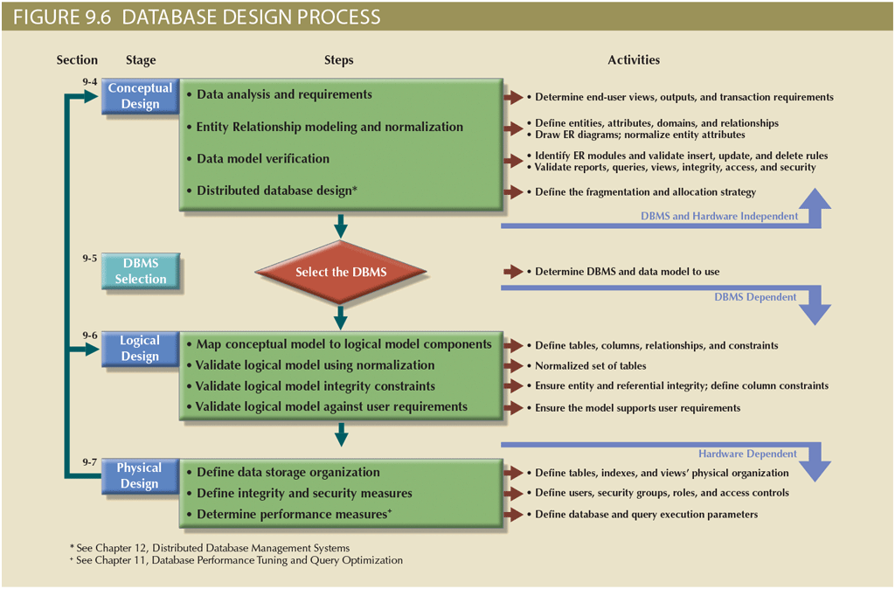
The Database Life Cycle (3 of 5)

Slide 10
The Database Life Cycle (4 of 5)
Table 9.1: Common Sources of Database Failure
Source | Description | Example
Software | Software-induced failures may be traceable to the operating system, the DBMS software, application programs, or viruses and other malware. | In April 2017, a new vulnerability was found in the Oracle E -Business Suite, that allows an unauthenticated attacker to create, modify, or delete critical data.
Hardware | Hardware-induced failures may include memory chip errors, disk crashes, bad disk sectors, and disk-full errors. | A bad memory module or a multiple hard disk failure in a database system can bring it to an abrupt stop.
Programming exemptions | Application programs or end users may roll back transactions when certain conditions are defined. Programming exemptions can also be caused by malicious or improperly tested code that can be exploited by hackers. | In February 2016 a group of unidentified hackers fraudulently instructed the New York Federal Reserve Bank to transfer $81 million from the central bank of Bangladesh to accounts in the Philippines. The hackers used fraudulent messages injected by malware disguised as a PDF reader.
Transactions | The system detects deadlocks and aborts one of the transactions. (See Chapter 10.) | Deadlock occurs when executing multiple simultaneous transactions.
External factors | Backups are especially important when a system suffers complete destruction from fire, earthquake, flood, or other natural disaster. | In August 2015, lightning struck a local utility provider’s grid near Google’s data centers in Belgium. Although power backup kicked in automatically, the interruption was long enough to cause permanent data loss in affected systems.

Slide 11
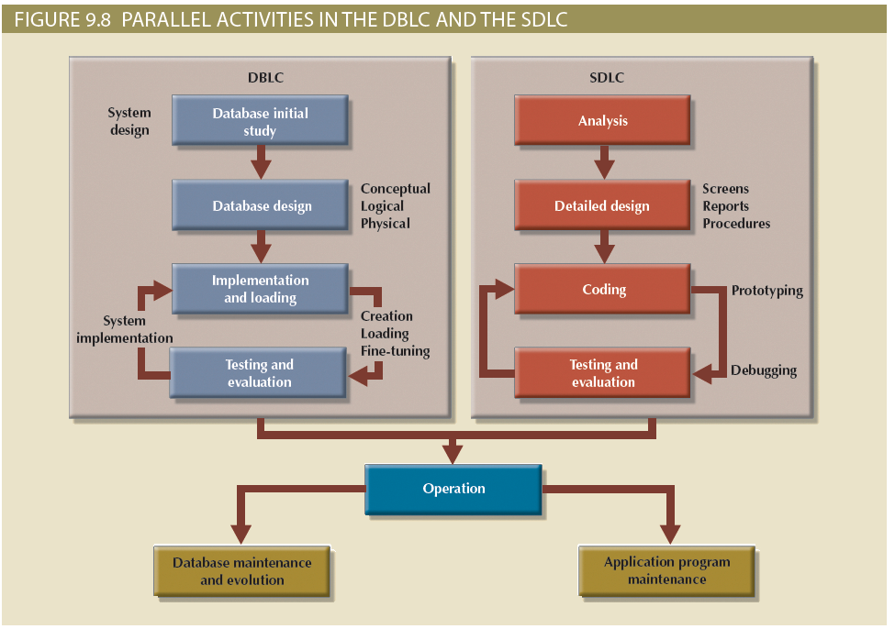
The Database Life Cycle (5 of 5)

Slide 12
Conceptual Design (1 of 10)
Goal: design a database independent of database software and physical details
Conceptual data model: describes main data entities, attributes, relationships, and constrains
Designed as software and hardware independent
Minimum data rule
All that is needed is there, and all that is there is needed

Slide 13
Conceptual Design (2 of 10)
 | Table 9.2: Conceptual Design Steps
Step | Activity
1 | Data analysis and requirements
2 | Entity relationship modeling and normalization
3 | Data model verification
4 | Distributed database design

Slide 14
Conceptual Design (3 of 10)
Data analysis and requirements
Designers efforts are focused
Information needs, users, sources and constitution
Answers obtained from a variety of sources
Developing and gathering end-user data views
Directly observing current system: existing and desired output
Interfacing with the systems design group
Entity relationship modeling and normalization
All objects (entities, attributes, relations, views, and so on) are defined in a data dictionary, which is used in tandem with the normalization process

Slide 15
Conceptual Design (4 of 10)
 | Table 9.3: Developing the Conceptual Model Using ER Diagrams
Step | Activity
1 | Identify, analyze, and refine the business rules
2 | Identify the main entities, using the results of Step 1
3 | Define the relationships among the entities, using the results of Steps 1 and 2
4 | Define the attributes, primary keys, and foreign keys for each of the entities
5 | Normalize the entities (remember that entities are implemented as tables in an RDBMS)
6 | Complete the initial ER diagram
7 | Validate the ER model against the end users’ information and processing requirements
8 | Modify the ER model, using the results of Step 7

Slide 16
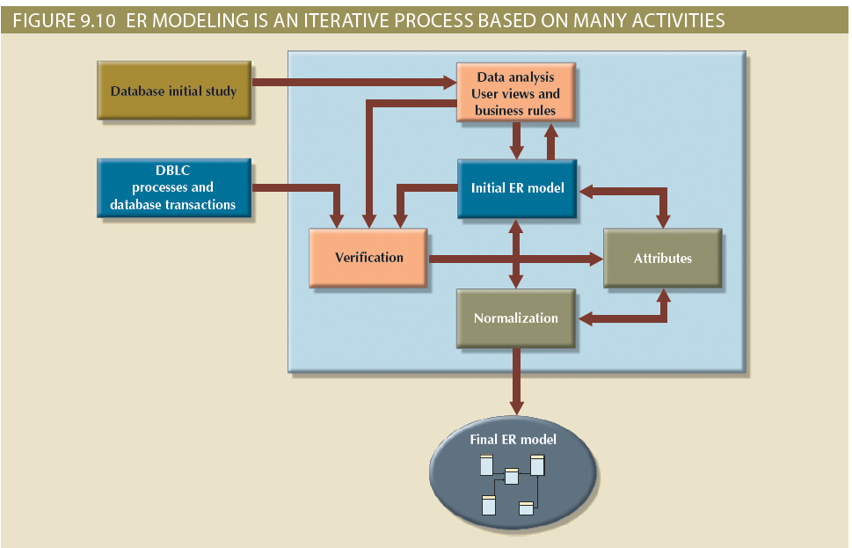
Conceptual Design (5 of 10)

Slide 17
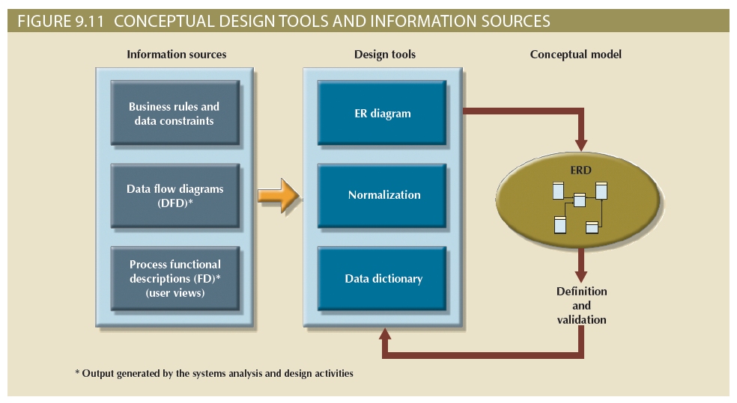
Conceptual Design (6 of 10)

Slide 18
Conceptual Design (7 of 10)
Data model verification
Verified against proposed system processes
Run through a series of tests
Important concepts
Module: information system component that handles specific business function
Cohesivity: strength of the relationships among the module’s entities
Module coupling: extent to which modules are independent to one another
Low coupling decreases unnecessary intermodule dependencies

Slide 19
Conceptual Design (8 of 10)
 | Table 9.5: The ER Model Verification Process
Step | Activity
1 | Identify the ER model’s central entity
2 | Identify each module and its components
3 | Identify each module’s transaction requirements: Internal: updates/inserts/deletes/queries/reports External: module interfaces
4 | Verify all processes against the module’s processing and reporting requirements
5 | Make all necessary changes suggested in Step 4
6 | Repeat Steps 2–5 for all modules

Slide 20
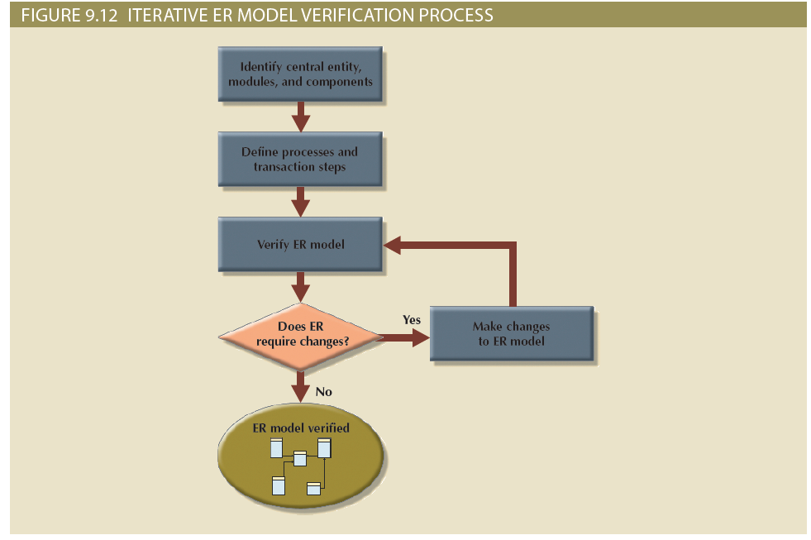
Conceptual Design (9 of 10)

Slide 21
Conceptual Design (10 of 10)
Distributed database design
Portions of database may reside in different physical locations
Database fragment: subset of a database stored at a given location
Ensures database integrity, security, and performance

Slide 22
DBMS Software Selection
Factors that affect the purchasing
Cost
DBMS features and tools
Underlying model
Portability
DBMS hardware requirements

Slide 23
Logical Design (1 of 3)
Goal: design an enterprise-wide database that is based on a specific data model but independent of physical-level details
Requires that all objects in the conceptual model be mapped to the specific constructs used by the selected database model
Validates logical model
Using normalization
Integrity constraints
Against user requirements

Slide 24
Logical Design (2 of 3)
 | Table 9.6: Logical Design Steps
Step | Activity
1 | Map the conceptual model to logical model components
2 | Validate the logical model using normalization
3 | Validate the logical model integrity constraints
4 | Validate the logical model against user requirements

Slide 25
Logical Design (3 of 3)
 | Table 9.7: Mapping the Conceptual Model to the Relational Model
Step | Activity
1 | Map strong entities
2 | Map supertype/subtype relationships
3 | Map weak entities
4 | Map binary relationships
5 | Map higher-degree relationships

Slide 26
Physical Design
Process of data storage organization and data access characteristics of the database; ensures integrity, security, and performance
Define data storage organization
Define integrity and security measures
Determine performance measures

Slide 27
Database Design Strategies (1 of 2)
Top-down design starts by identifying the data sets and then defines the data elements for each of those sets
Involves the identification of different entity types and the definition of each entity’s attributes
Bottom-up design first identifies the data elements (items) and then groups them together in data sets
First defines attributes, and then groups them to form entities

Slide 28
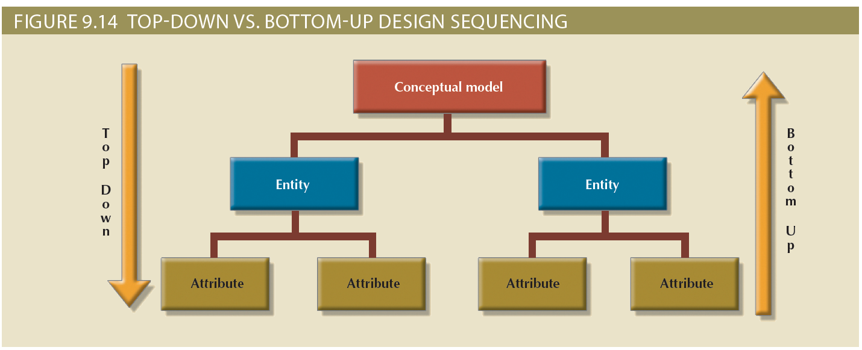
Database Design Strategies (2 of 2)

Slide 29
Centralized versus Decentralized Design (1 of 4)
Centralized design: process by which all database design decisions are carried out centrally by a small group of people
Suitable in a top-down design approach when the problem domain is relatively small, as in a single unit or department in an organization
Decentralized design: process in which conceptual design models subsets of an organization’s database requirements, which are then aggregated into a complete design
Such modular designs are typical of complex systems with a relatively large number of objects and procedures

Slide 30
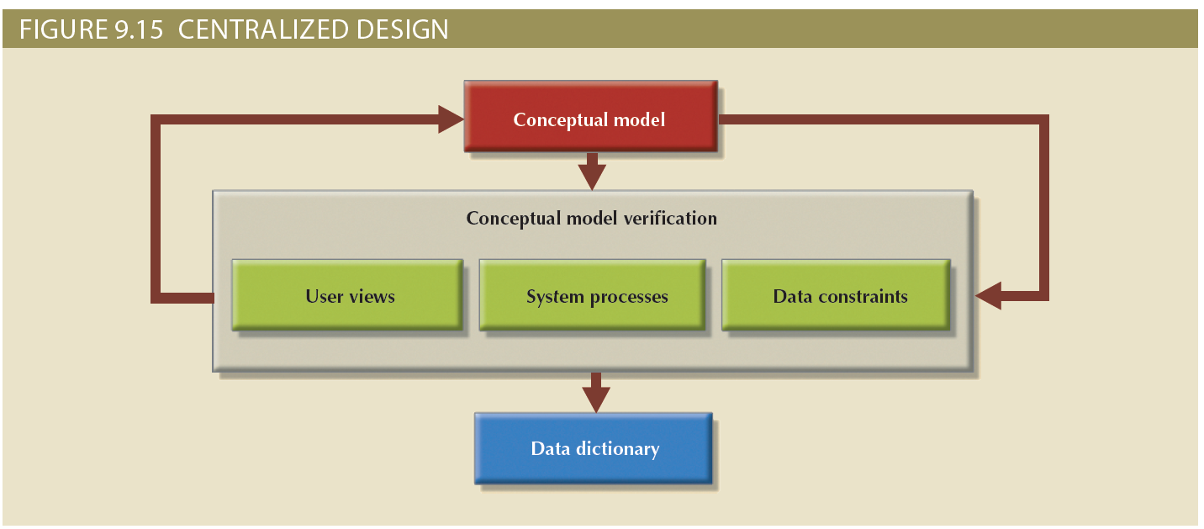
Centralized versus Decentralized Design (2 of 4)

Slide 31
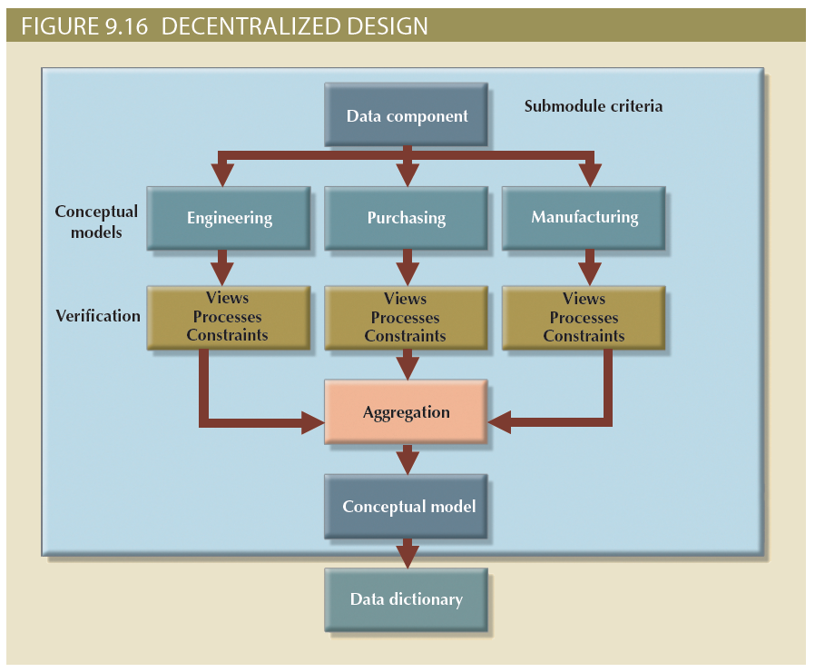
Centralized versus Decentralized Design (3 of 4)

Slide 32
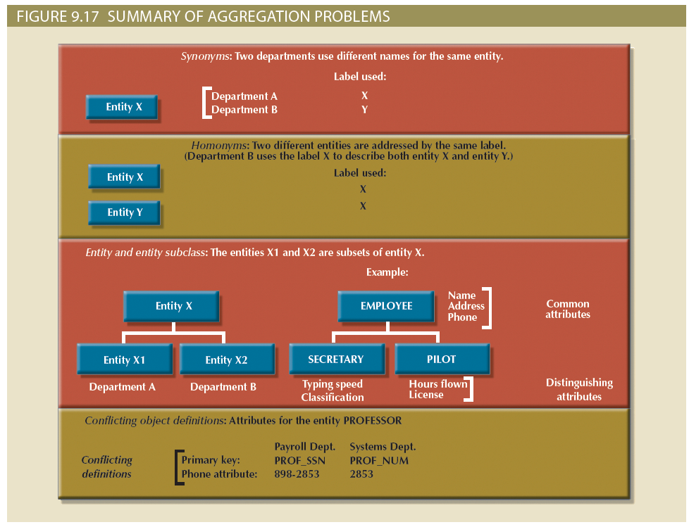
Centralized versus Decentralized Design (4 of 4)

Slide 33
Summary
An information system is designed to help transform data into information and to manage both data and information
The Systems Development Life Cycle (SDLC) traces the history of an application within the information system
The Database Life Cycle (DBLC) describes the history of the database within the information system
The conceptual portion of the design may be subject to several variations based on two basic design philosophies: bottom-up versus top-down and centralized versus decentralized

